Slide 1
Headline
Writing Standard 1.3: Organization and Focus
Please print this slide show, follow the directions, and staple it to your reading response.

Slide 2
Formatting Your Article
Tape or staple two pieces of paper together or create a Microsoft Word document formatted in landscape (the wide way)
Create four equal columns
Leave enough space across the page for an eye-grabbing headline
On the left, draw a picture-box one column wide and nine lines deep
Below the picture-box, write your first and last name. Below that, write “Staff Reporter”
Begin your article in the first column below the picture

Slide 3
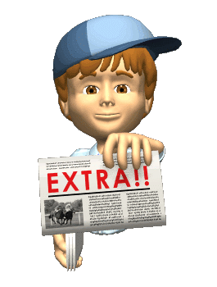
Formula for a Well-Written News Article
First Paragraph In your first one or two sentences tell who, what, when, where, and why. Try to hook the reader by beginning with a clever or surprising statement. Go for variety: try beginning your article with a question or a provocative statement. (75+ words)
Second/Third/Fourth Paragraphs Give the reader the details. Include one or two quotes from people involved with the event. Write in the third person (he, she, it, they.) Be objective (never state your opinion). Use quotes to express others' opinions about what happened. (75+ words)
Last Paragraph:
Wrap it up somehow (don't leave the reader hanging. Please don't say, "In conclusion…" or "To finish..." (yawn!) Try ending with a quote from someone involved in the case or with your own catchy phrase. (75+ words)

Slide 4
Mr. J. Video Quick Tip
Writing Tips:
Use active words (verbs that show what's really happening.)
Write about the really interesting info first!

Slide 5
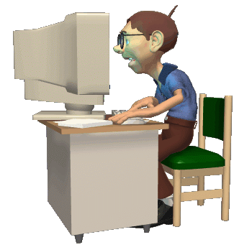
Guidelines for Writing
Has a catchy title that encourages people to read the article
Article is based on the most important event in the story or chapter
Contains the most important information in the first paragraph
Covers in depth who, what, when, where, why, and how
Used your best English and remained objective (un-opinionated)
Contains at least two direct citations of at least two sentences each (parenthetically cited)
Relatively free of grammatical, mechanical, and spelling errors
Each paragraph is at least 75 words
Printed or word processed

Slide 6
RANCHER QUESTIONED IN SOLEDAD MURDER MYSTERY
After interviewing most of the ranchers, some pretty
interesting facts emerged from the Soledad ranch. It seems as if Mr. Small was inside of the barn with the puppy he enjoyed playing with, while the others were playing horseshoes. Mr. Small’s best friend George Milton described him as being a nice, friendly guy. He stated that Lennie wasn’t “all there in his head and sometimes got himself in trouble” (Steinbeck 93). Well, it appears that Mr. Milton and his co-worker Candy came across the woman’s dead body inside the same barn Mr. Small was seen earlier. Candy stated what was going through his mind when he walked in the barn, and all he could spit out was “Oh, Jesus Christ!” (93). His knowledge surrounding the woman’s death seemed unclear. Ranchers were still shaken by the women’s death.
While there are no witnesses, investigators believe Mr. Small my had killed Curley’s wife. It looks like she may have died instantly because
her neck was found broken and the only other person in the
barn at the time was Mr. Small. Mr. Milton told authorities that
his friend had some trouble at their last job in Weed, California, and he had a feeling it was bound to happen again. “Lennie never done it in meanness,” he said. “All the time he done bad things, but he never done on of ‘em mean” (95). Mr. Milton was with the other men when Curley’s wife was found as in not a suspect.
However, Mr. Small was mysteriously missing after the death of the woman, so how did his own death come about? Initially, rumors circulated that maybe he killed himself out of guilt, but investigators quickly removed that as a possible answer. His dead body was found by the Salinas River, late afternoon. Upon speaking with Mr. Milton, he stated how “guys like us got no fambly. They make a little stake an’ then they blow it in. They ain’t got nobody in the worl’ that gives a hoot in hell
about ‘em“(104).
Slim, a co-worker of Mr. Milton, later told investigators that Mr. Milton told him it was the most difficult thing he had to do. He and Lennie had been best friends growing up, but he said
he had no other choice. He just had to do it, then continue going about his business and live his life without any more complications from Lennie. He knew that his dear friend did not mean any of the trouble that he caused, but it was more than he could bear. “I just done it” (107).
Murder and mystery have now left their mark on Soledad, California. At the scene, local authorities continued to question Mr. Milton for his role in Mr. Small’s death and speculation is that he may shortly be charged for taking the law into his own hands and killing Mr. Milton rather that detaining him and turning him over to the police for questioning. Perhaps Mr. Milton felt his plan was best, but too often the best laid plans of mice and men often go awry.
Allie Visk
Staff Writer
Man and woman, both found dead in Soledad, California. But, you ask, who? Why? How? The very well known wife of Curley, and a man by the name of Lennie Small, just trying to make some money both died not much more than five hours ago. The question that is still being asked though is “Why?” Was there a purpose to each of their mysterious deaths? Maybe it was an accident, or quite possibly it could have been planned out for reasons only a courtroom trial will reveal.

Slide 7
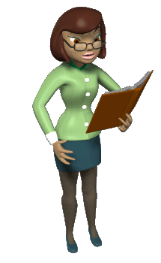
Grading Guidelines
Catchy Title
2 Direct Citations (2+ Sentences each)
Correct Parenthetical Format
Word Count
350+ Words = No errors
300+ Words = 1 error
250+ Words = 2 errors
200+ Words = 3 errors
150+ Words = 4+ errors
Quality of Article:
Evaluative (Goes Beyond) = No errors
Analytical (Learned What was taught) = 1 error
Application (Understands Simple Concepts) = 2 errors
Comprehension (Understands Simple Concepts with Help) = 3 errors
Knowledge Building (Needs Considerable Help Understanding Simple Concepts) = 4+ errors
Photo Related to Story
Staff Byline

Slide 8
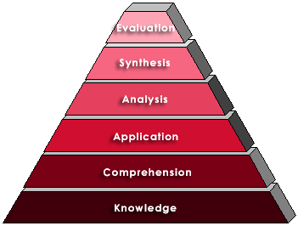
Writing Standard 1.3: Organization and Focus
Creativity
Evaluation
Write one sentence explaining what you did well according to the skill being learned using the language of Bloom’s taxonomy. Then, write one more sentence explaining what you could do better or differently next time and how you could move up one level on Bloom’s Taxonomy.
Higher Order Thinking Skills
4.5 to 5/A
3.5 to 4.4/B
2.5 to 3.4/C
1.5 to 2.4/L
.1 to 1.4/K
Bloom’s Taxonomy
Student Directions for Written Evaluation
Lower Order Thinking Skills
Grading Scale
0 Errors = 4.5/A to 5/A 3 Errors - = 1.5/L to 2.4/L
1 Errors = 3.5/B to 4.4/B 4+ Errors = .1/K to 1.4/K
2 Errors = 2.5/C to 3.4/C

Slide 9
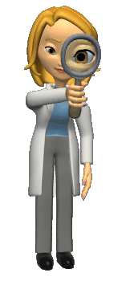
Printing Directions
On the tool bar, click on “File,” click on “Print.”
In the “Print” dialogue box, in the lower left corner under “Print What,” click on the drop down arrow and select “Handouts.”
Then, under “Color/Grayscale,” select the best on for your printer.
Next, under “Handouts,” click on “Slides per Page,” and choose “9.”
Lastly, click on “OK,” and the file will print.

